Slide 1

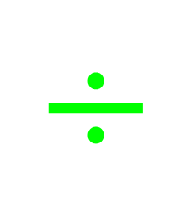







My Number Interactive Notebook
$$×$$
$$\frac{1}{2}$$
$$÷$$
$$+$$
$$−$$
$$\frac{3}{5}$$
$$7$$
Name
Class
Teacher
Term 1 Semester 1
$$5^{2}$$
$$\sqrt{9}$$
1

Slide 2
Create your own front page
It needs to contain the following –
My number interactive notebook
Name
Class
Teachers Name
Semester 1 Term 1
Page number 1

Slide 3
Contents
Glossary or Formula Page
Page
Date
Description
2
3

Slide 4
Tasks
24
7
30
Essential Question
Questions
Notes
Summary
4
5

Slide 5
24
7
30
Date
Index Notation
EQ – Describe how to calculate square and cube numbers?
5

Slide 6
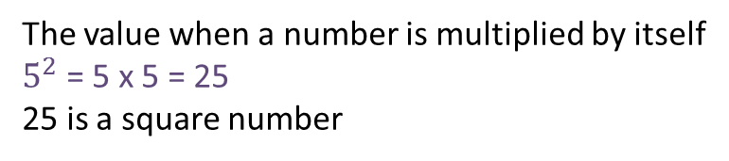
24
7
30
Date
Index Notation
EQ – Describe how to calculate square and cube numbers?
What is a square number?
The value when a number is multiplied by itself
$5^{2}$ = 5 x 5 = 25
25 is a square number
5

Slide 7
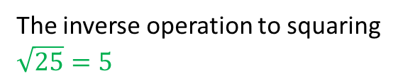
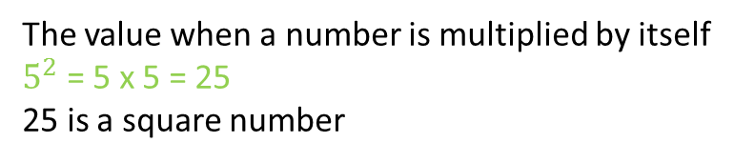
24
7
30
Date
Index Notation
EQ – Describe how to calculate square and cube numbers?
What is a square number?
The value when a number is multiplied by itself
$5^{2}$ = 5 x 5 = 25
25 is a square number
What the square root?
The inverse operation to squaring
$$\sqrt{25}=5$$
5

Slide 8
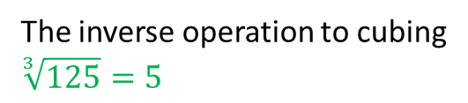
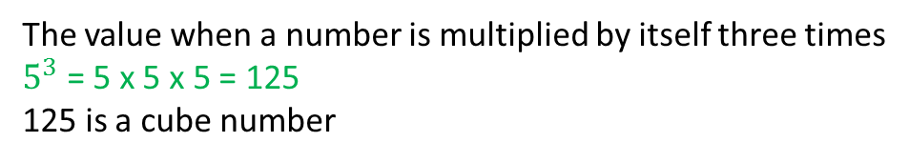
24
7
30
Date
Index Notation
EQ – EQ – Describe how to calculate square and cube numbers?
?
What is a square number?
The value when a number is multiplied by itself
$5^{2}$ = 5 x 5 = 25
25 is a square number
What the square root?
The inverse operation to squaring
$$\sqrt{25}=5$$
What is a cube number?
The value when a number is multiplied by itself three times
$5^{3}$ = 5 x 5 x 5 = 125
125 is a cube number
The inverse operation to cubing
$$\sqrt[3]{125}=5$$
What the cube root?
5

Slide 9

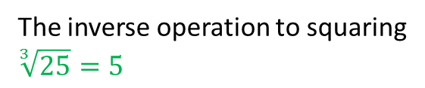

24
7
30
Date
Index Notation
EQ – ?
What is a square number?
The value when a number is multiplied by itself
$5^{2}$ = 5 x 5 = 25
25 is a square number
What the square root?
The inverse operation to squaring
$$\sqrt{25}=5$$
What is a cube number?
The value when a number is multiplied by itself
$5^{3}$ = 5 x 5 = 25
25 is a square number
The inverse operation to squaring
$$\sqrt[3]{25}=5$$
What the cube root?
Calculator Buttons
$x^{2}$ $x^{3} \sqrt{} \sqrt[3]{}$
5

Slide 10
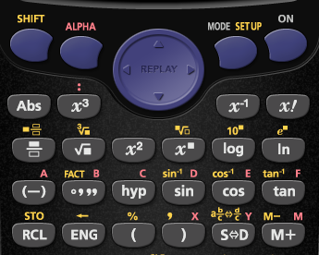




$$x^{2}$$
$$x^{3}$$
$$\sqrt[3]{}$$

Slide 11
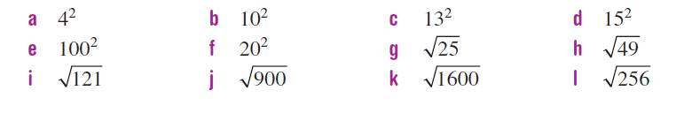
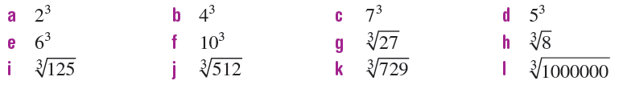
1.
2.

Slide 12


1.
2.

Slide 13
Notes Review
24, 7 ,30
Date
Title
Essential question
Notes complete
Notes complete with colour and diagrams
Questions completed
Contents page filed in
Formula page filled in

Slide 14
Homework
Review your notes and write a summary answering the essential question.

